Slide 1
Apposcopy: Semantics-Based Detection of Android Malware through Static Analysis

Slide 2
Taint analysis
Pro:
Exposing apps that leak sensitive data in a
sound way.
Cons:
Block legitimate apps.
Notes:
Last week Alex and Brian from team1 taught about Flow Droid. This is a good tool to do taint analysis on Android apps.
They talked about source and sink.
At last of last lecture, they also mentioned that source and sink APIs are collected in certain file to be used, which I‘ll mention later.

Slide 3
Taint analysis
Pro:
Exposing apps that leak sensitive data in a
sound way.
Cons:
Block legitimate apps.
Internet
Notes:
We can get call log, contact list, credit card information as source, do some propagation before use the source data, which we define as sink.
This technique can help to expose every data using point, but it will also block out legitimate app functions like Yelp can get your location information to show restaurants around you, which should not be taken as data leaking.(false positive)

Slide 4
Signature based
Signature based malware detectors:
Certain string values of method or variables.
Pro:
Represent a corpus of malware through finite
signatures.
Detect malware accurately.
Cons:
Update signature frequently;
Obfuscation by bytecode transformation.
Notes:
We can also detect malware through signatures, like this picture, this is gold dream, a sample android Trojan horse which steals information from android devices. This gold dream creates a service called ‘zjService’. definitely we can create a signature based on the string‘zjService'.But it will be really easy to bypass through obfuscation or even just change the string ‘zjService’, and also the signature will change so frequently.

Slide 5
Problem: How to combine advantages of taint analysis and signature based detection?
Apposcopy:
Semantics-Based Detection of Android Malware through Static Analysis
goal: Fewer false positives
Resist common obfuscation
The false positive rate is the proportion of all
negatives that still yield positive test outcomes
The false negative rate is the proportion of
positives which yield negative test outcomes
Notes:
so team from University of Texas at Austin present a way to solve the problem of combining the advantages of taint analysis and signature based detection.
They present Apposcopy, aim to minimize the false positives of taint analysis and resist common obfuscation.
We have a little definition here that false positive is that we have all things negative but there still exist some positive report
and the false positive rate is is the proportion of all negatives that still yield positive test outcomes

Slide 6
Idea from Android Apps
Control flow properties
(Inter-component
communication)
Can Activity A launch Service B?
Data flow properties
(Taint analysis)
Can Receiver C send sensitive data to internet?
Notes:
Now lets come back to android apps, we consider two properties we have. one is control flow property, an example represent this is “can activity a launch service B?”
the other one is data flow property, this is “can receiver c send my credit card information to internet?” this data flow character has already exist in taint analysis techniqe.

Slide 7
Idea from Android Apps
Control flow properties
(Inter-component
communication)
Can Activity A launch Service B?
Our signature should reflect
the Inter-component communication.
Data flow properties
(Taint analysis)
Can Receiver C send sensitive data to internet?
Notes:
So our signature to identify android malwares should reflect the inter component communication property of these malwares.

Slide 8
Idea from Android Apps
Control flow properties
(Inter-component
communication)
Can Activity A launch Service B?
Malware spec Language to create signature
Data flow properties
(Taint analysis)
Can Receiver C send sensitive data to internet?
Notes:
In this paper, they create a malware spec language to create signature.

Slide 9
Apposcopy
Overview
Notes:
They overview of apposcopy is this.
First we need to create signature of malwares, then input app to detect if it is a malware based on the known malware signature.

Slide 10
Apposcopy
Overview
15 families
Control flow properties
Data flow properties
Notes:
The author has write 15 families’ signature in the paper, not a huge number to work around.

Slide 11
Apposcopy
Overview
Automated Synthesis of Semantic Malware Signatures using Maximum Satisfiability.
Yu Feng, Osbert Bastani, Ruben Martins, Isil Dillig, Saswat Anand. NDSS 2017.
Notes:
but it is till hard to create signatures, so this team with Stanford university create a system called MaxSAT to automatedly generate malware signature.
this reach out a paper called Auto
PPT
, but it is not contained in our presentation.

Slide 12
Example
Notes:
Now, we can look into the Apposcopy through an example.
Still the gold dream

Slide 13
Example
Notes:
first we do taint analysis on this malware, look into the red Rounded Rectangle. there are 4 pairs of source and sink shown over there

Slide 14
Example
Notes:
On the right side is the simplified signature example.
I know its abrupt to show this without any explanation, but I will show the detail of it in a few minutes.
Because after showing you all the steps of this example, you will know what each step’s purpose is, and then I will explain the theory.
its easy to read right over there right, the flow get source of devicedid and sink it into Internet.
this is called data flow predicate.
This is the data flow property of this malware.
And we also notice there are other source sink flows in adactivities, but these are not considered as malicious behaviors.

Slide 15
Example
ICCG: Inter-Component Call Graph, a high level abstraction of android apps
Control-flow properties matching through ICCG construction
Intent Analysis: Resolve the target component
Data Type, Action…
Component A
Component B
Notes:
The next one is Inter-Component Call Graph, this is a high level abstraction of android apps,
which represent apps’ control flow property
And intent analysis is what we have to analysis here, like component A input Type A, Action to Component B to do something, this is like a call graph.

Slide 16
Example
ICCG: Inter-Component Call Graph, a high level abstraction of android apps
Control-flow properties matching through ICCG construction
Intent Analysis: Resolve the target component
Data Type, Action…
Component A
Component B
Notes:
in this gold dream malware. a simplified ICCG is shown above, Lets look into the rounded rectangle.

Slide 17
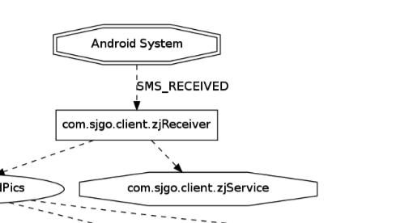
Example
there exists a node in the ICCG representing a receiver component (namely, zjReceiver)
there is an edge from the node representing the Android system to zjReceiver labeled with SMS_RECEIVED
zjReceiver has an outgoing edge to a service component called zjService
Notes:
the third line is component predicate
the fourth line is ICC predicate
this is the signature build in predicate ability, seems like the zjReceiver receive something and send something into Service.
Actually this means there exists a node in ICCG as a reciever.
And there is an edge from the node receiver to the node service
This is the control flow property

Slide 18
Example
there exists a node in the ICCG representing a receiver component (namely, zjReceiver)
there is an edge from the node representing the Android system to zjReceiver labeled with SMS_RECEIVED
zjReceiver has an outgoing edge to a service component called zjService
Notes:
Based on all these features, the signature will work nicely without putting to much false positive.
Because the signature has already filter the legal data flow out, only focus on those malicious ones.
Then I’ll give the definitions of these predications and how the malware spec language come out

Slide 19
Look into Malware SPEC Language
Datalog Preliminaries
Apposcopy Build-in Predicate
Conponent Type Predicate
Predicate ICC
df1
df2
df3
ex1
df4
predicate calls
predicate flows
df5
df6
df7
ex2
Notes:
Lets look the catalog of the technique detail, we have 7 definitions and 2 examples to show how spec languange work

Slide 20
Look into Malware SPEC Language
Datalog Preliminaries
Example:
Ancestor(x, y) :- parent(x,z), ancestor(z,y)
ancestor(x, y) is true if both parent(x,z), ancestor(z,y) are true.
Notes:
This spec language is base on datalog programming, we know prolog is a kind of logical programming right?
Then we look back the signature

Slide 21
Look into Malware SPEC Language
Datalog Preliminaries
Example:
Ancestor(x, y) :- parent(x,z), ancestor(z,y)
ancestor(x, y) is true if both parent(x,z), ancestor(z,y) are true.
Notes:
Then we look back the signature, if all 34567 lines are true, we can directly say that this is a gold dream family malware

Slide 22
Look into Malware SPEC Language
Apposcopy Build-in Predicate
Conponent Type Predicate
Corresponding to each of these Android components, Apposcopy provides pre-defined predicates
called service(C), activity(C), receiver(C), and contentprovider(C) which represent the type of
component C.
For example, activity(C) is true if C is an Activity. Each of these four predicates correspond to
relations of type (comp : C) where domain C is the set of all components in the application
Notes:
And this is the component type predicate
PPT

Slide 23
Look into Malware SPEC Language
Apposcopy Build-in Predicate
Predicate ICC
ICC site
Notes:
A key idea behind inter-component communication (ICC) in Android is that of Intents, which are messages passed between components. Intents are used to start Activities; start, stop, and bind Services; and broadcast information to Broadcast Receivers. Table 1 shows a list of Android APIs that are used in ICC. We refer to those methods, all of which take Intent ob jects as arguments, as ICC method s. We use the term ICC site to represent a statement that invokes one of the ICC methods listed in Table 1. When component a initiates ICC with component b, the Android system will eventually call life-cycle methods associated with component b. The life-cycle methods are shown in Table 2.

Slide 24
Look into Malware SPEC Language
Apposcopy Build-in Predicate
Predicate ICC
icc (source : C, target : C, action : A, data : D)
Example:
icc(p, q, a, d)
Notes:
While an Intent object passed to ICC methods can contain many different types of information, Apposcopy’s signature language takes into account only two kinds: action and data.
if predicate icc(p,q,a,d) is true, this means that component p passes an intent to q through invocation of an ICC method, and a and d represent the action and data strings of the intent. To formally state the semantics of the icc predicate, we first define targets of ICC sites:

Slide 25
Look into Malware SPEC Language
Definition 1. The target of an ICC site, m(i, . . .), is the set of components that will receive the intent stored in variable i in some execution of the application.
Definition 2. We write m1 -> m2 if method m1 directly calls m2 in some execution of the program. We define ->* to be the reflexive transitive closure of ->.
In other words, m1 ->* m2 if m1 transitively calls m2.
Definition 3. The predicate icc(p,q,a,d) is true if
(i) m1 is a life-cycle method defined in component p,
(ii) m1 ->* m2,
(iii) m2 contains an ICC site whose target is component q, and
(iv) the action and data values of the intent are a and d, respectively.
Apposcopy Build-in Predicate
Predicate ICC
icc (source : C, target : C, action : A, data : D)
Example:
icc(p, q, a, d)
Notes:
definitions

Slide 26
Look into Malware SPEC Language
Definition 1. The target of an ICC site, m(i, . . .), is the set of components that will receive the intent stored in variable i in some execution of the application.
Definition 2. We write m1 ->* m2 if method m1 directly calls m2 in some execution of the program. We define ->* to be the reflexive transitive closure of ->.
In other words, m1 ->* m2 if m1 transitively calls m2.
Definition 3. The predicate icc(p,q,a,d) is true if
(i) m1 is a life-cycle method defined in component p,
(ii) m1 ->* m2,
(iii) m2 contains an ICC site whose target is component q, and
(iv) the action and data values of the intent are a and d, respectively.
Apposcopy Build-in Predicate
Predicate ICC
icc (source : C, target : C, action : A, data : D)
Example:
icc(p, q, a, d)
Notes:
Lets see this example.
Consider the code in Figure 3, which defines two activities, MainAct and MsgAct. The onCreate life-cycle method of MainAct calls foo which initiates ICC at line 10 by calling startActivity with intent i. The action associ- ated with intent i is SEND and the data type is text/plain. According to the manifest in Figure 4, MsgAct declares an intent filter for SEND actions on data type text/plain, mean- ing that msgAct is a target of the ICC site at line 10. Hence, predicate icc(MainAct, MsgAct, SEND, text/plain) is true.

Slide 27
Look into Malware SPEC Language
icc(MainAct, MsgAct, SEND, text/plain) is true
Apposcopy Build-in Predicate
Predicate ICC
icc (source : C, target : C, action : A, data : D)
Example:
icc(p, q, a, d)
Notes:
Lets see this example.
Consider the code in Figure 3, which defines two activities, MainAct and MsgAct. The onCreate life-cycle method of MainAct calls foo which initiates ICC at line 10 by calling startActivity with intent i. The action associ- ated with intent i is SEND and the data type is text/plain. According to the manifest in Figure 4, MsgAct declares an intent filter for SEND actions on data type text/plain, mean- ing that msgAct is a target of the ICC site at line 10. Hence, predicate icc(MainAct, MsgAct, SEND, text/plain) is true.

Slide 28
Look into Malware SPEC Language
Definition 4. Let icc_direct(p,q) be a binary predicate which is true if icc(p, q, _, _) is true.
The predicate icc* is the reflexive transitive closure of icc_direct.
Apposcopy Build-in Predicate
Predicate ICC
icc (source : C, target : C, action : A, data : D)
Example:
icc*(p, q)
Notes:
We havent finish this icc predicate yet
We now have the last definition in icc predicate
4

Slide 29
Look into Malware SPEC Language
Apposcopy Build-in Predicate
predicate calls
Call(component(C), Method(M))
Notes:
Apposcopy provides another control-flow predicate, called calls, representing a relation of type (comp : C,callee : M) where domains C and M represent the set of all com- ponents and methods in the program respectively. Intu- itively, calls(c,m) is true if method m is called by component c. More precisely, calls(c, m) is true if n is a life-cycle method defined in component c and n Y⋆ m.
The calls predicate is useful for defining malware signatures because it can be used to check if a component calls Android API methods that can be abused by malware. Table 3 lists a few of such dangerous methods.
Some malware might directly calls these methods, so we can directly write call() in signature. But in glod dream we don’t have call in its signature.

Slide 30
Definition 6. A taint flow (so,si) represents that a source labeled so can flow to a sink labeled si through a series of assignments or matching loads and stores.
Definition 7. The predicate flow(p,so,q,si) is true if (i) m and n are the source and sink methods corresponding to source so and sink si,
(ii) calls(p, m) and calls(q,n) are both true, and
(iii) there exists a taint flow (so,si).
Look into Malware SPEC Language
Apposcopy Build-in Predicate
predicate flows
Notes:
At last we define flow

Slide 31
Definition 6. A taint flow (so,si) represents that a source labeled so can flow to a sink labeled si through a series of assignments or matching loads and stores.
Definition 7. The predicate flow(p,so,q,si) is true if (i) m and n are the source and sink methods corresponding to source so and sink si,
(ii) calls(p, m) and calls(q,n) are both true, and
(iii) there exists a taint flow (so,si).
Look into Malware SPEC Language
Apposcopy Build-in Predicate
predicate flows
Notes:
At last we define flow
We also have to know what kind of methods are source and sink methods, and this a table shows

Slide 32
Definition 6. A taint flow (so,si) represents that a source labeled so can flow to a sink labeled si through a series of assignments or matching loads and stores.
Definition 7. The predicate flow(p,so,q,si) is true if (i) m and n are the source and sink methods corresponding to source so and sink si,
(ii) calls(p, m) and calls(q,n) are both true, and
(iii) there exists a taint flow (so,si).
Look into Malware SPEC Language
Apposcopy Build-in Predicate
predicate flows
flow(ListDevice,$getDeviceId,ListDevice,!sendTextMessage) is true
Notes:
Then it will be easy to explain this sample code.

Slide 33
Static Analysis
Pointer Analysis & Call-graph Construction
Inter-component Control-flow Analysis
Data flow analysis for Intents
ex3
ICCG construction
ex4
Taint Analysis
Annotations
ex5
Static Taint Analysis
ex6
Definition 2. We write m1 ->* m2 if method m1 directly calls m2 in some execution of the program. We define ->* to be the reflexive transitive closure of ->.
In other words, m1 ->* m2 if m1 transitively calls m2.
An edge in the call-graph from method m1 to method m2 corresponds to m1 -> m2. Similarly, m1 ->* m2 represents that there exists a path in the call-graph from m1 to m2.
Notes:
Then we come to the static analysis part of Apposcopy
In this part, the paper contains many notations and functions
This section describes Apposcopy’s static analyses for deciding whether an application matches a malware signature. The main idea is to compute an over-approximation of the icc, calls, and flow relations.
On pointer analysis, the paper dosen’t show detail of the algorithm, but it gives a paper reference to a hybrid algorithm with call-site sensitivity for static method calls and object-sensitivity for virtual memory calls.
The paper mostly talk about call graph construction algorithm, and this algorithm actually implement the definition 2

Slide 34
Static Analysis
Inter-component Control-flow Analysis
Data flow analysis for Intents
ex3
ICCG construction
ex4
Definition . An ICCG for a program P is a graph (N,E) such that nodes N are the set of components in P, and edges E define a relation E ⊆ (N ×A×D×N) where A and D are the domain of all actions and data types defined by the Android system augmented with the element ⊥.
Notes:
Then lets see the formal definition of ICCG
PPT
Let’s ignore the notation first
In other words, ICCG is a directed graph where nodes are components in an application, and edges are labeled with actions and data types. The special element ⊥ indicates that the intent defining the ICC does not have action or data type information associated with it.
Given a callgraph and the results of the pointer analysis, Apposcopy constructs the ICCG by performing two key steps that we explain next.

Slide 35
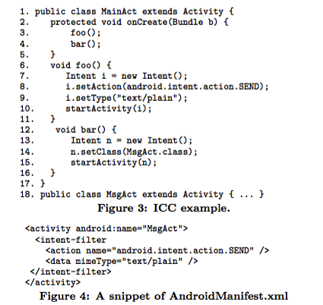
Static Analysis
Inter-component Control-flow Analysis
Data flow analysis for Intents
icc(MainAct, MsgAct, SEND, text/plain) is true
Notes:
First, is the data flow analysis for intents. In this part the paper define Target action and data type.
PPT
When a component does not specify the target of an intent explicitly, the Android system resolves the recipient components of the ICC based on intent filters declared in the manifest file. An intent filter specifies the kinds of actions that a component will respond to. For instance, consider the AndroidManifest.xml file from Figure 4. Here, MsgAct declares that it responds to intents whose corresponding action and data type are SEND and text/plain respectively.

Slide 36
Static Analysis
Inter-component Control-flow Analysis
Data flow analysis for Intents
Notes:
This functions are used to define ICCG constructions
I will explain
must alias
May alias
The notation 拐
Notation 指
Now, consider the statement x.setComponent(s) where x is a variable of type Intent and s is a string specifying the target component. If another variable y is an alias of x, then the target of y will also be affected by this state- ment. Hence, our transfer function must update the data flow values of all variables that are aliases of x. Now, there are three cases to consider. If x and y are guaranteed to be aliases, as in the first rule of Figure 6, then we can kill its old value and update its new value to {s} (i.e., a strong update). In the second rule, if y may alias x, then y’s target could either remain unchanged or becomes; hence, we only perform a weak update. Finally, if y and x do not alias, then y’s target definitely remains unchanged and its existing dataflow values are preserved. The may alias and must alias relations used in Figure 6 are defined according to Figure 7. In the definition of the must alias relation, γ(o) represents the set of concrete memory locations represented by abstract memory location o.

Slide 37
Static Analysis
Inter-component Control-flow Analysis
Data flow analysis for Intents
icc(MainAct, MsgAct, SEND, text/plain) is true
Notes:
Explain 土
So the annotation of this means, the paper didn’t define it but we can easily guess the meaning of it is whatever the type of this thing, I can infer it.

Slide 38
Static Analysis
Inter-component Control-flow Analysis
ICCG construction

Slide 39
Static Analysis
Inter-component Control-flow Analysis
ICCG construction
icc(MainAct, MsgAct, SEND, text/plain) is true

Slide 40
Static Analysis
Taint Analysis
Annotations
ex5
Static Taint Analysis
ex6
Notes:
Finally the taint analysis part comes

Slide 41
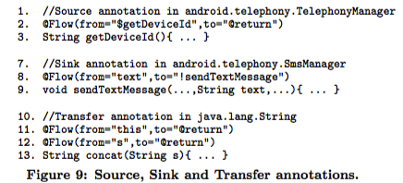
Static Analysis
Taint Analysis
Annotations
Notes:
The paper manually written annotations for Android SDK methods that propagate taint between parameters and return values.
Example 5. Figure 9 shows representative examples of source, sink, and transfer annotations. All three kinds of specifications are written using the @Flow annotation, and sources and sinks are indicated by the special prefixes $ and ! respectively. In Figure 9, the annotation at line 2 is a source annotation, indicating that getDeviceId’s return value is a taint source. The sink annotation at line 8 indicates that
sendTextMessage is a sink for its formal parameter text. Lines 11-12 correspond to transfer annotations for the An- droid library method concat which is not analyzed by Apposcopy. According to line 11, if the this parameter of concat is tainted, then its return value is also tainted. Similarly, the annotation at line 12 states that if parameter s of concat is tainted, then so is the return value.
The paper emphasize that the source, sink, and transfer annotations are not written by individual users of Apposcopy, which already comes with a set of built-in annotations that we have written. Apposcopy uses the same pre-defined annotations for analyzing every Android application.

Slide 42
Static Analysis
Definition 6. A taint flow (so,si) represents that a source labeled so can flow to a sink labeled si through a series of assignments or matching loads and stores.
Definition 7. The predicate flow(p,so,q,si) is true if (i) m and n are the source and sink methods corresponding to source so and sink si,
(ii) calls(p, m) and calls(q,n) are both true, and
(iii) there exists a taint flow (so,si).
Taint Analysis
Static Taint Analysis
Notes:
Apposcopy’s taint analysis using the inference rules shown in Figure 10. And this rule represent signatures definition 6 and 7
Lets just show it by example

Slide 43
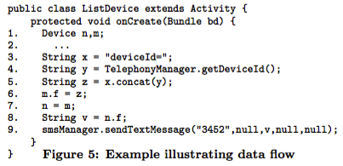
Static Analysis
Taint Analysis
Static Taint Analysis

Slide 44
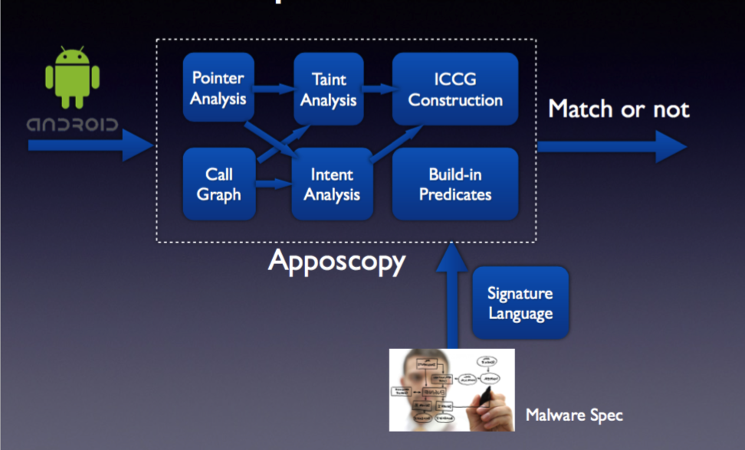
Apposcopy
Implementation
Notes:
Finally, we get the implementation of Apposcopy like this.
it contains pointer analysis, taint analysis, intent analysis. It analyze Inter component graph, call graph and also have a build in predicate logic based on its malware spec language

Slide 45
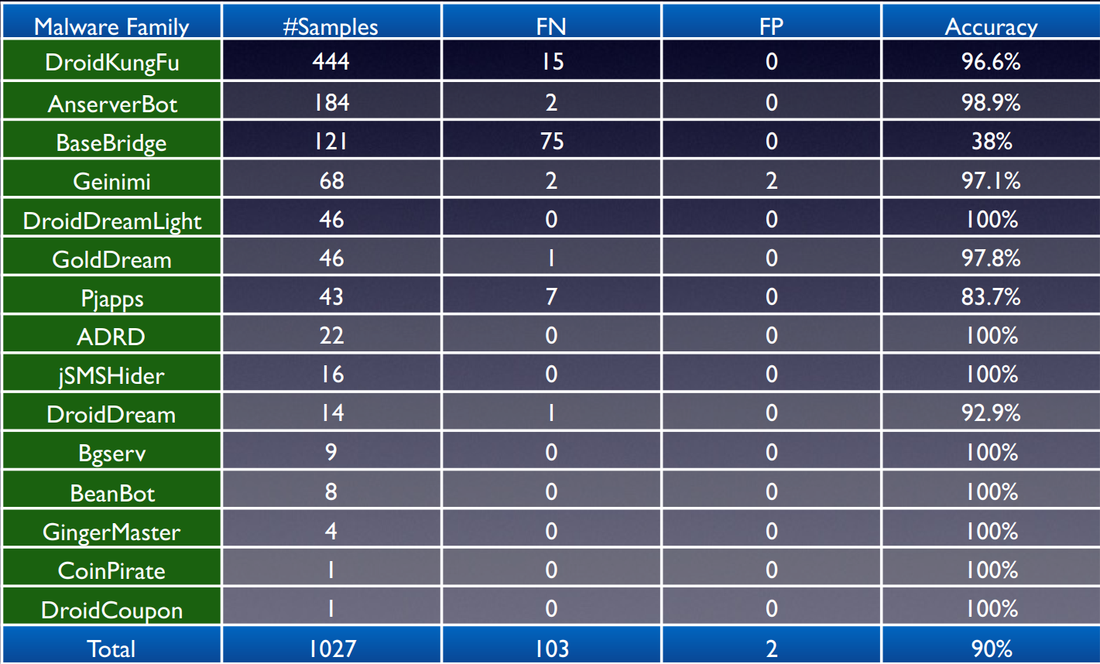
Experiment on Known Malware

Slide 46
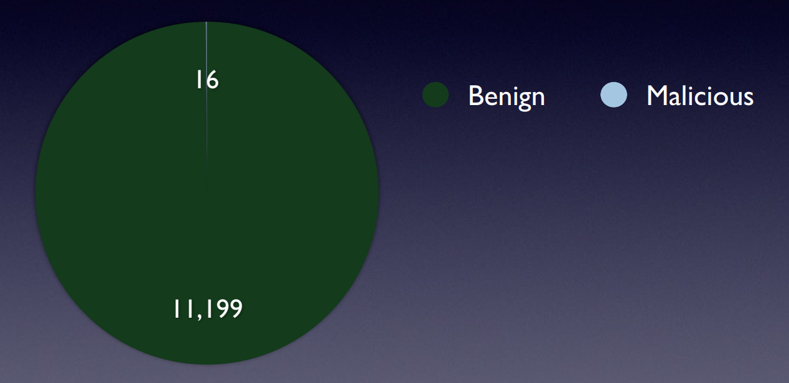
Experiment on Google Play Apps
Notes:
13 out 16.

Slide 47
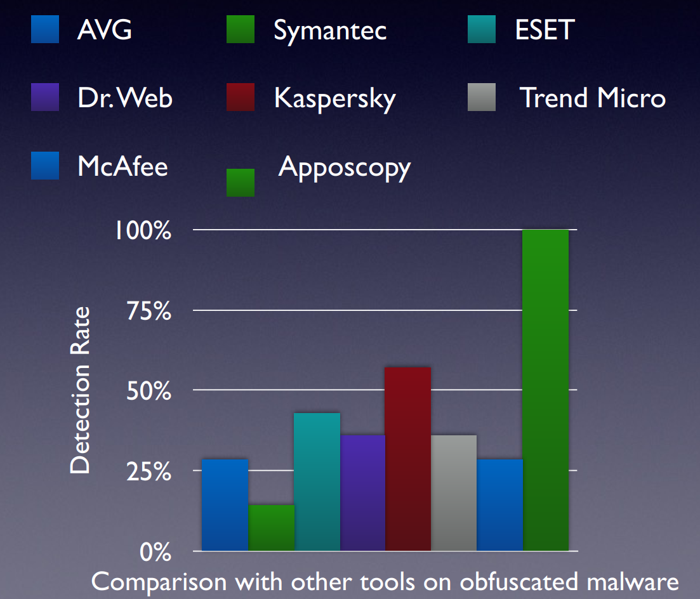
Experiment on Obfuscated Apps

Slide 48
Compare with Kirin
False negative:
Kirin: 48%
Apposcopy: 10%
False positive when perform on Google Play apps:
Kirin: 8%
Apposcopy: 0.14%

Slide 49
Limitations
- Could be defeated by a suitable designed automatic obfuscator - might be defeated by obfuscation techniques such as dynamic code loading (BaseBridge) and use of reflection in combination with obfuscation of method or class names - but such attempts to escape detection are likely to be treated as suspicious behavior - Perform deep static analysis through an App - not a instant detection method - can be deployed to scan apps as they are submitted to App Store
Notes:
The limitations of

